Slide 1
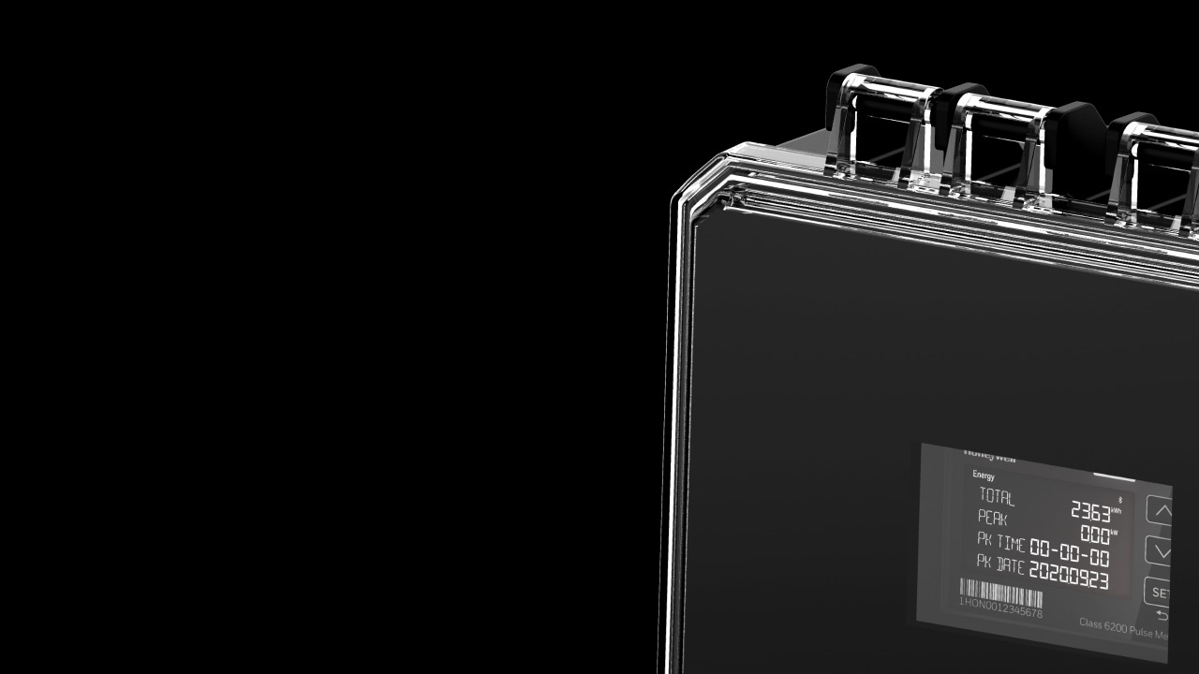

E-MON CLASS 6000
Monitor. Measure.
Manage With confidence
Energy Meters with Smart Monitoring
Patty Hall
electrical channel Sales Leader
Notes:
Hello and welcome to today’s webinar! (SMILE!)
Please standby. We’ll allow a few more minutes for others to join and will start the webinar momentarily.
<Allow 1-2 minutes for audience to join>
Let’s get started! Thank you for joining us and welcome to today’s webinar. My name is Patty Hall and I’m the Electrical Channel Sales Leader in the Honeywell BMS business.
With me today is our Honeywell Subject matter expert, Justin Van Riper. who will be available for questions at the end of the webinar.
We will begin shortly, however first I have a few housekeeping notes to review. The topic of today’s webinar is the Benefits of Adding the E-Mon Energy Meter to BMS Installations, plus we will share information about the launch of our new Class 6000 meter. This webinar is being recorded and is scheduled to last one-hour.
There will be a live Q&A session at the end of the webinar, please use the question box at the bottom of your screen to submit questions.
If you are watching on-demand, please either complete the survey on your engagement menu below for someone to contact you or go to the LIVE CHAT function afterwards to get connected sooner.
Please make sure you’ve adjusted your volume to the right levels.
Here we go!

Slide 2
Speaker intro
Patty Hall is the Electrical Channel Sales Leader covering the US and Canada. In this position, Patty is dedicated to driving sales of HBT BMS products through the Electrical channel and increasing sales of E-MON products through the Trade channel. She leads the electrical sales leaders and their network of manufacturer representatives reps.
Notes:
A quick introduction of who I am. I am a 32-year Honeywell employee whose career has spanned 3 different Honeywell business units. I am fortunate to have led several Honeywell sales teams in a variety of sales leadership positions. And I am a certified six sigma Black Belt. Today I am dedicated to driving sales of HBT E-Mon and BMS products through the Electrical channel and increasing sales of E-MON products through the Trade channel. I am extremely excited to lead the electrical regional sales leaders and their network of manufacturer’s reps. This is an exciting and fun position, especially as we launch our new Class 6000 meter, which you will hear about shortly!
With that let’s jump into the presentation!

Slide 3
agenda
WHY SUBMETERING
E-MON PORTFOLIO
INTRODUCING E-MON CLASS 6000
Q & A
Notes:
Here is a quick look at today’s agenda.
In the “Why Submetering” section I will share with you the benefits of adding the E-Mon Energy Meter to BMS Installations
Next, I will share with you the “E-MON PORTFOLIO” that is available to you today and give you a peak at how the new Class 6000 roadmap relates to the legacy portfolio.
The 3rd topic on the agenda is what I know many of you are looking forward to hearing about! I am extremely happy to introduce our new E-Mon Class 6000 submeter and the value propositions that you can leverage for your business.
Lastly, Justin Van Riper will join me in a Q & A session where we look forward to hearing from you!

Slide 4
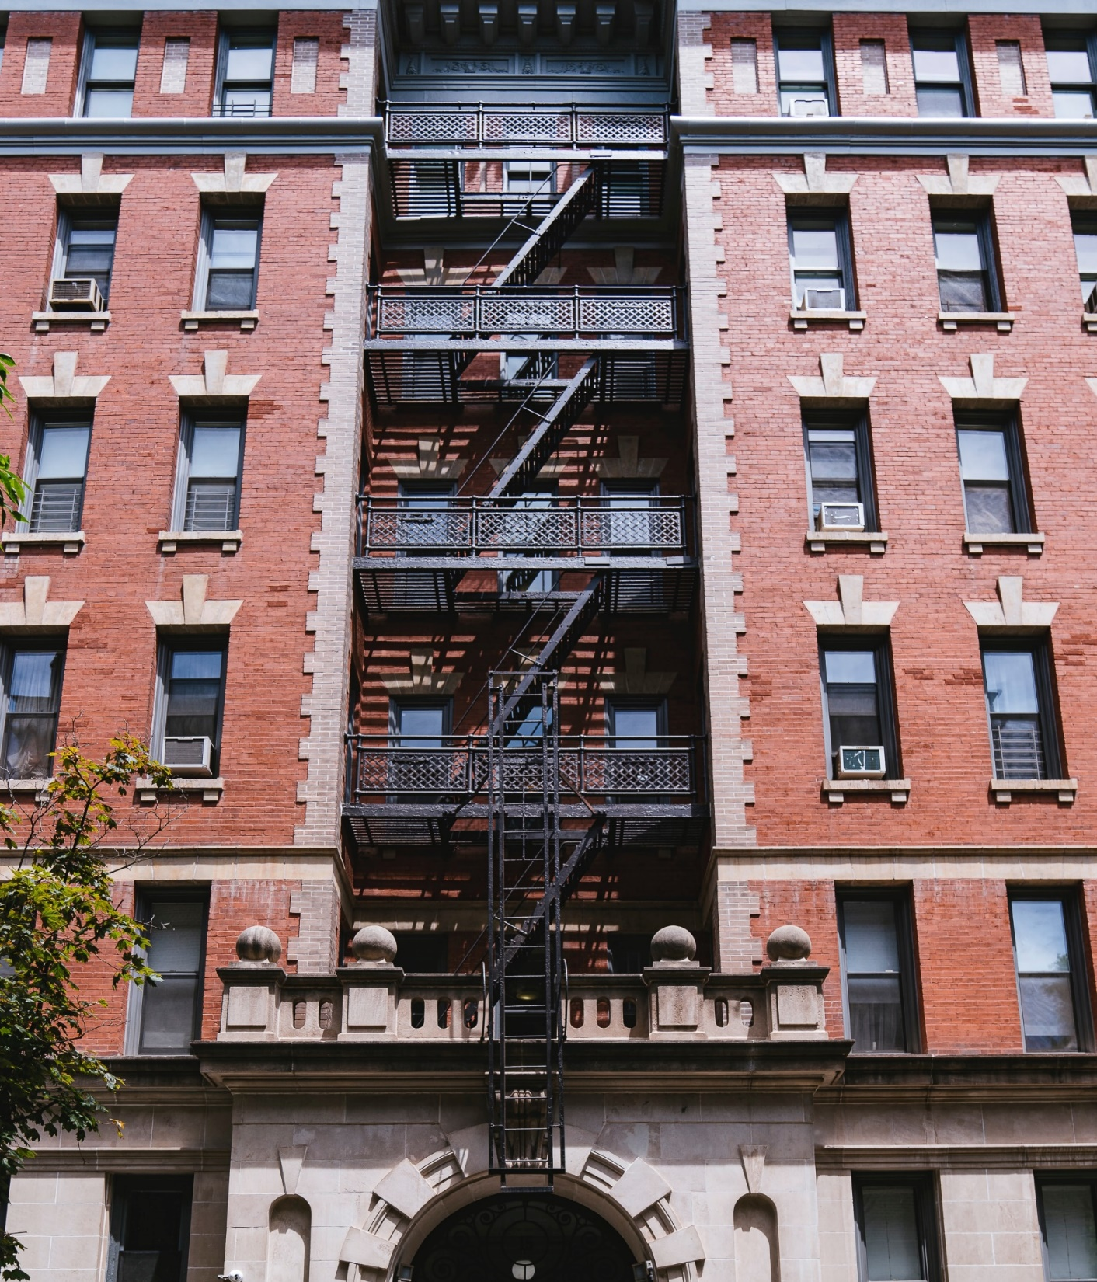
Why Submeter?
“Submetering is the only fair way to allocate utility costs amongst multi-suite properties. Traditional bulk metering takes the aggregate of the building’s utility usage and costs, and then splits it up equally to all suites based on square footage. This is an unfair way of splitting utility costs. Because submetering directly ties billings costs to actual consumption, submeter installation typically reduces consumption of each sub-metered utility 15-25% in​ commercial buildings and by 18-39% in multi-tenant residential properties.”
-National Apartment Association and National Multi-Housing Council Study
Notes:
First introduced in the early 1980’s E-Mon is the industry leader in submetering hardware and software. E-Mon electric meters are installed on the facility side of the master utility meter. Used in conjunction with automatic meter reading software, submetering systems provide accurate and timely snapshots of a facility’s energy use – from a single circuit or device all the way up to an entire building and beyond.
With rising energy costs, we see continued pressure on business owners of commercial, industrial, institutional and multi-family residential facility to leave no stone unturned in finding ways to reduce operating cost. In fact, today, we are seeing a pivot from the traditional submeter users I just noted expand to include airports, hospitals, data centers, and many more verticals! End-users of all types have turned to submetering to identify when and where energy is used in order to implement energy conservation measures and programs.
E-Mon submetering products and systems give end users visibility into where and when energy is consumed in their building. Meters are used to monitor actual usage by department, tenant or common area and report back to computerized systems for billing allocation, analysis and management.

Slide 5
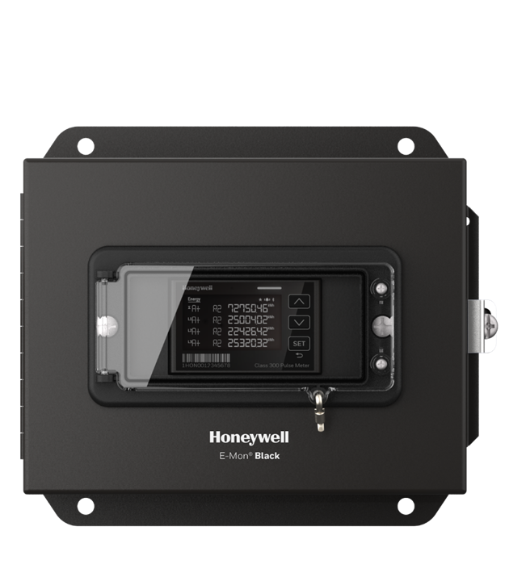
Submetering energy analysis
Energy Management
Measurement & Verification
Load Profiling
Tenant Billing
Cost Allocation
Green Buildings-LEED Certification
Power Quality
  Increase energy efficiency of a facility
  Increase life time of electrical distribution equipment
  Increase life time of electrical equipment such as motors and generators
Notes:
For building owners, the type of data needed in today’s sophisticated facility goes beyond the capability of the Master utility meter. Submeters deliver high accuracy interval data snapshots of energy use and demand from enterprise level all the way down to a specific circuit or item of equipment. As this slide shows, submeters provide energy information for energy management, measurement & verification, Load profiling. Tenant billing for example, in facilities where there are multiple tenants, monitoring actual consumption is a win-win situation for both the building owner and the tenants.
We’ve talked about cost allocation and how submetering allows the building owner to fairly allocate utility costs amongst multi-suite properties.
Green Buildings and Leed certification. When it comes to LEED Certification, E-Mon can assist with LEED certification point in several areas including measurement & verification and much more…. And, of course power quality.
To sum it up, submeters play an integral role in providing granular interval energy data to building automation systems to facilitate important energy decisions.

Slide 6





Submetering applications
Airports
Banking and Finance
Datacenters
Education
Food Processing and Food Retail
Government and Utilities
Healthcare, Hospitals and Pharmaceuticals
Hospitality
Logistics
Commercial – office & retail
Multi-Family Residential
Industrial / Manufacturing
Notes:
Submeter applications are everywhere you turn. Traditionally, you will see E-Mon submeters in the commercial office and Multi-family residential space. As well as in all the verticals you see listed. With the renewed focus on Healthy Buildings, we are pivoting, with an increased emphasis to work with consulting engineers and architect to ensure E-Mon is specified across all the verticals. We will leave “no stone unturned” to ensure E-Mon is on the specification so our partners can include E-Mon in their submittal on bid day.

Slide 7
Honeywell
E-mon portfolio
Notes:
Let’s talk about the E-Mon portfolio. In this section I am going to review a little about our portfolio today and move into where we are headed.

Slide 8
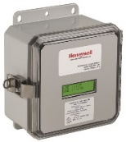
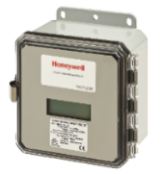
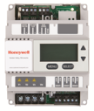
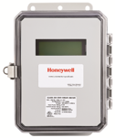
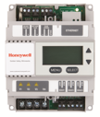
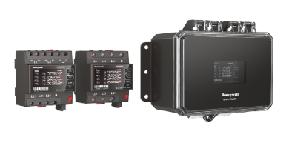
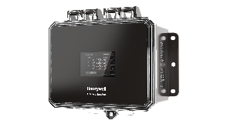
E-Mon Portfolio
Pulse Output
Smart Meters
Wireless
Introducing E-Mon Class 6000
E-Mon Class 6200 (3-phase pulse) in December
E-Mon Class 6310 (RS485 communicating) coming soon
Single-Phase
Three-Phase
RS-485/
Dual Protocol
IP/
Dual Protocol
Class
1000
Class
2000
Class
3200
D-Mon
D2
Class
3400
Class
5000
D-Mon
D5
LEGACY
E-Mon
Class 6100
Class 6200
Pulse
Class 6310
RS-485
Class
6330 Ethernet
Class 6340 Wireless
NEW
E-Mon Class 6000
*Coming Later
*Available
In Q4 2020
*Available Soon
*Coming Later
*Coming Later
Notes:
As you look at the top half of this table, you see the products that many of you are familiar with today. The Class 1000 & 2000 meters provide the basic building blocks of an affordable, effective and scalable energy management system. We move into the E-Mon smart meters with the Class 3200, 3400, and 5000 meters. Smart meters are called on for energy, power quality and BAS integration. The smart meters provide an extended feature set with a wider range of metering functions, basic and dual protocol for load control, net metering, expanded memory and storage and much more. Most smart meters offer communication capabilities for integration with automatic meter reading software and BAS systems billing packages or measurement and verification reporting programs via industry standard communication protocols. All of these products and many more are available to you today!
The second level of this graph you see our new E-Mon Class 6000 roadmap! I am excited to introduce the Class 6000 to you today! E-Mon Class 6000 is a revenue-grade solution that allows you to install in less time, commission and configure via display or dedicated app where you can capture precise data and allocate energy costs with confidence!
The Class 6200 pulse meter is available in Q4, with the Class 6300 RS-485 communicating model following in early 2021! You can see the roadmap for this product includes Ethernet and wireless in the future! Now the fun begins as I introduce Honeywell E-Mon’s new Class 6200 meter!

Slide 9

Notes:
https://www.youtube.com/watch?v=UcSxbc0xkwM

Slide 10
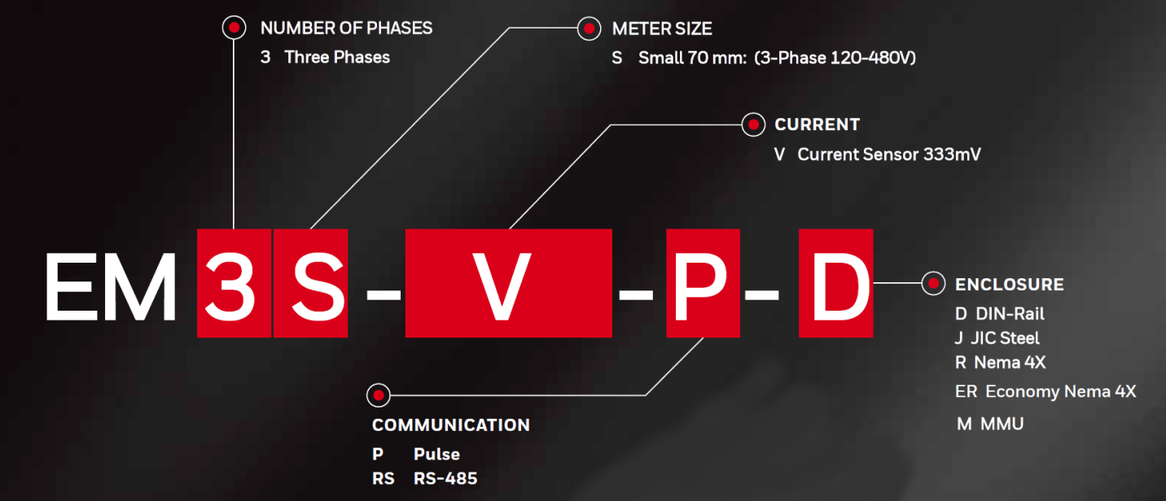
Class 6000 Sku Matrix
Notes:
I won’t spend a lot of time on this slide. It provides a quick look at how easy it is to put together the part number that you need for your application.

Slide 11
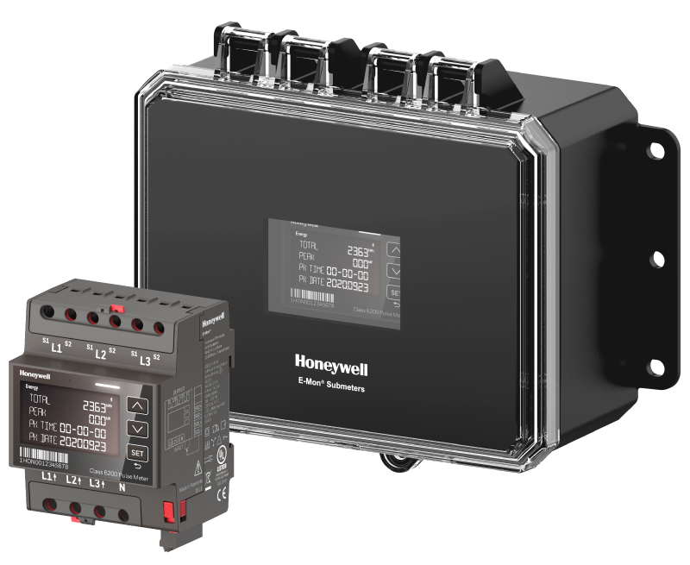
E-Mon CLASS 6000
Initial Offering: Class 6200 Pulse Meter
Application: Sub-billing (revenue grade), Cost Analysis, Energy and Demand Monitoring
Key Differentiating Features:
  More installation safety with dedicated enclosures and cabinets
  1 SKU for all applications for higher stock-ability
  Advanced commissioning functions for faster and fail safe setup via display and/or Android app
  Value Proposition
  Pulse meter, which is easy to stock, fast and safe to install, supported by an Android app
Notes:
Safer to install with improved enclosures, cabinets and current sensors
1 meter for all applications – easy to stock and order
Fast and Failsafe commissioning. Especially for several meters.

Slide 12
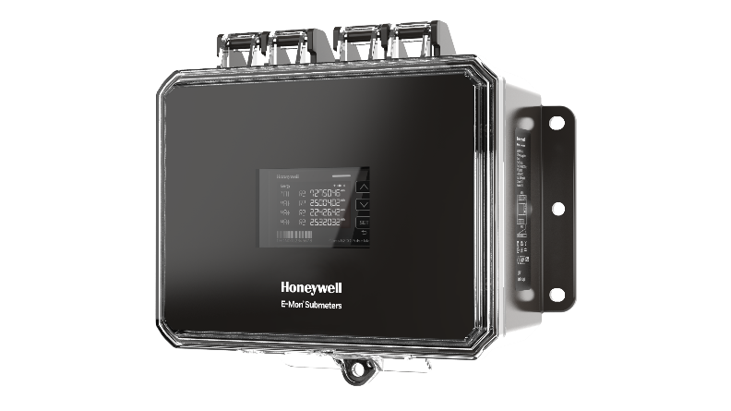
Optimized performance at every stage
DESIGN
INSTALL
COMMISSION
OPERATE
ANALYSIS
CYBERSECURITY
3D Model Support
Newer and safer enclosure and cabinet design
Compact and flexible design
Wiring check function
Meters are Field Configurable to Current Sensors
Easy and reliable readouts with Bluetooth communication
Reliable analysis of consumption data
Data security and lockable enclosures
POWERFUL FEATURES
Stockable meter with auto-ranging power input 110 through 480 Volts
Meters are field configurable to current sensors 25 Amp through 5,000 Amps
Wiring check on both meter display and Android App
Easy to integrate with 1000 pulses per kWh per default, easy on-site parametrization
Revenue Grade Approved ANSI C12.20 Class 0.5
Safety UL listed standard 61010-2 latest submeter approval
Notes:
Honeywell E-Mon has optimized performance at every stage. I am going to take a few minutes to walk through each stage.
What you will find – state the features.
These powerful features – lays the groundwork for the value that you will bring to your customer with the E-Mon Class 6000.
Let’s move on to the first stage.

Slide 13
DESIGN
INSTALL
COMMISSION
OPERATE
ANALYSE
CYBERSECURITY
DESIGN
INSTALL
COMMISSION
OPERATE
ANALYSE
CYBERSECURITY

Slide 14

DESIGN
EFFICIENT AND FLEXIBLE
SPECIFICATION
  The next generation of E-Mon® provides you with a significantly easier design system thanks to its broad range of helpful options. This includes pre-written engineering specifications that come in various formats and a range of engineering icons for established design tools like AutoCAD, E-Plan, etc. We support building information modelling (BIM) with building information models that include 3D data for Autodesk Revit and CREO.
BIM support
3D data and objects for integration into BIM
Online CPQ configurator
Online configurator for simplified and faster product selection
Notes:
The E-Mon Class 6000 provides an easier design system, including pre-written engineering specifications. You will find a range of engineering icons for established design tools like AutoCAD and E-Plan. We support 3D data and objects for integration into BIM. Honeywell’s online CPQ configurator.
This Online configurator allows for simplified and faster product selection.

Slide 15
DESIGN
DESIGN
CYBERSECURITY
INSTALL
CYBERSECURITY
INSTALL
COMMISSION
COMMISSION
OPERATE
OPERATE
ANALYSE
ANALYSE

Slide 16
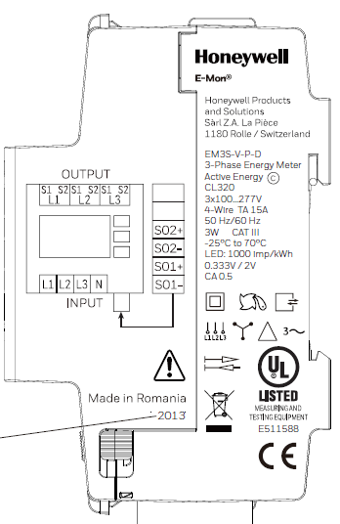
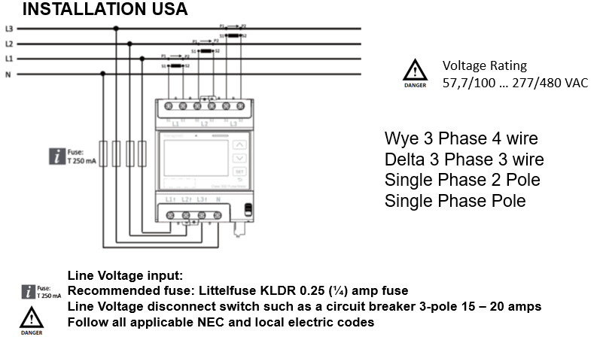
INSTALL
SAFE INSTALLATION WITH A COMPACT METER
AND NEW ENCLOSURE DESIGN
Compatible with most system wirings:
Star/Wye (Neutral connected): 3P4W, Px-N, Px-Py-N
Delta (Neutral not connected):
3P3W
Notes:
Install is simplified with troubleshooting installation and commissioning in real time. The installer has the choice to use the android app or program straight from the display. The status display alerts installer to errors on both the display and app. The new enclosure increases the simplicity of the install!

Slide 17
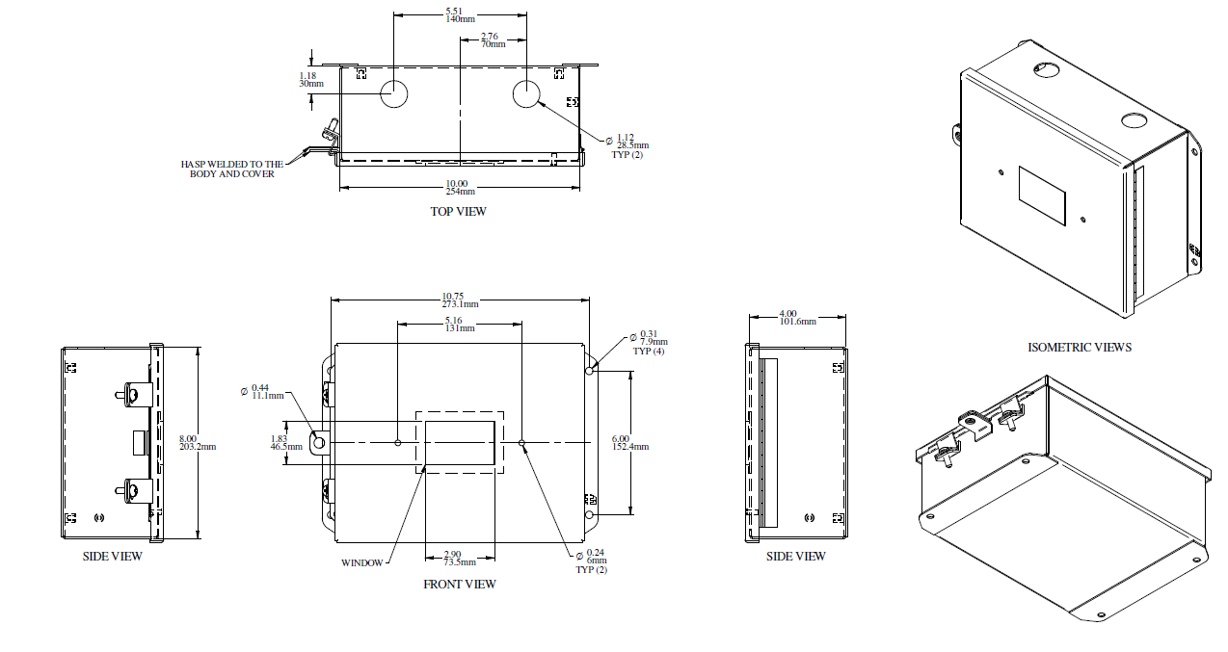
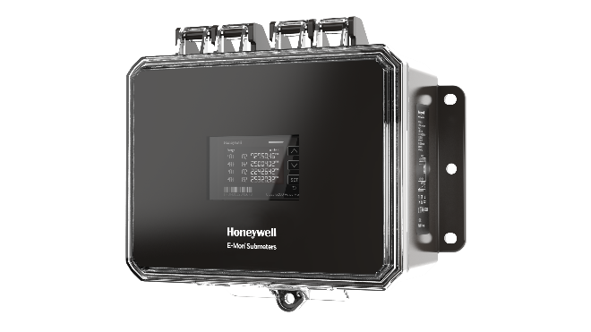
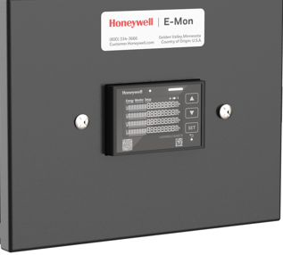
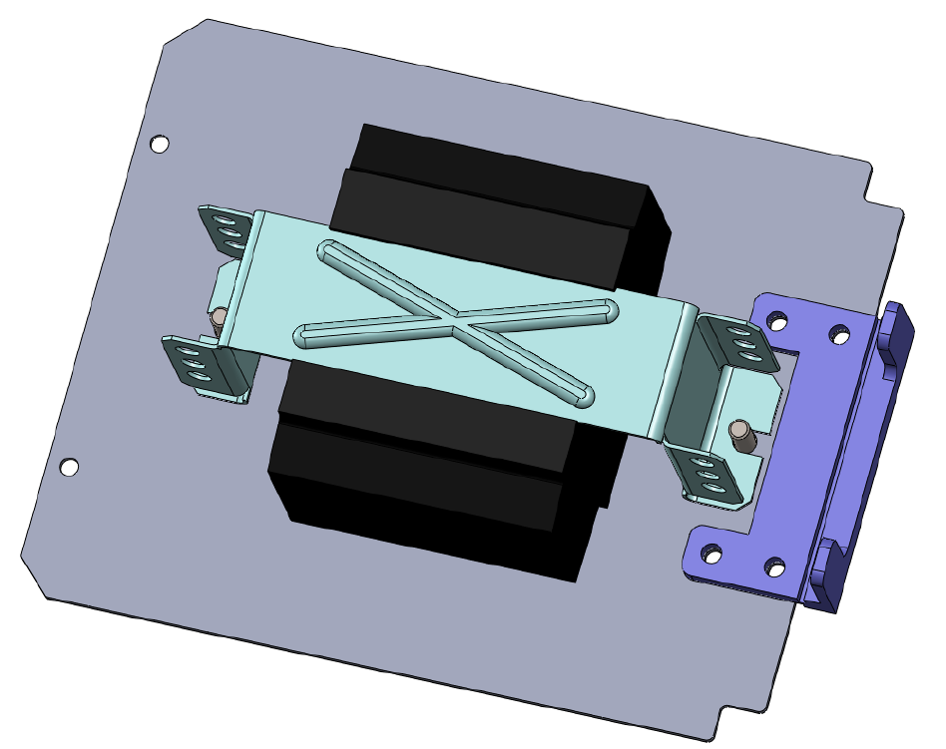
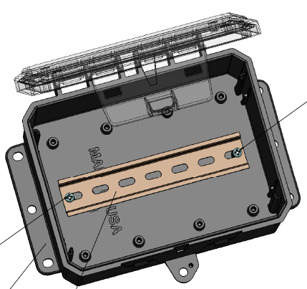
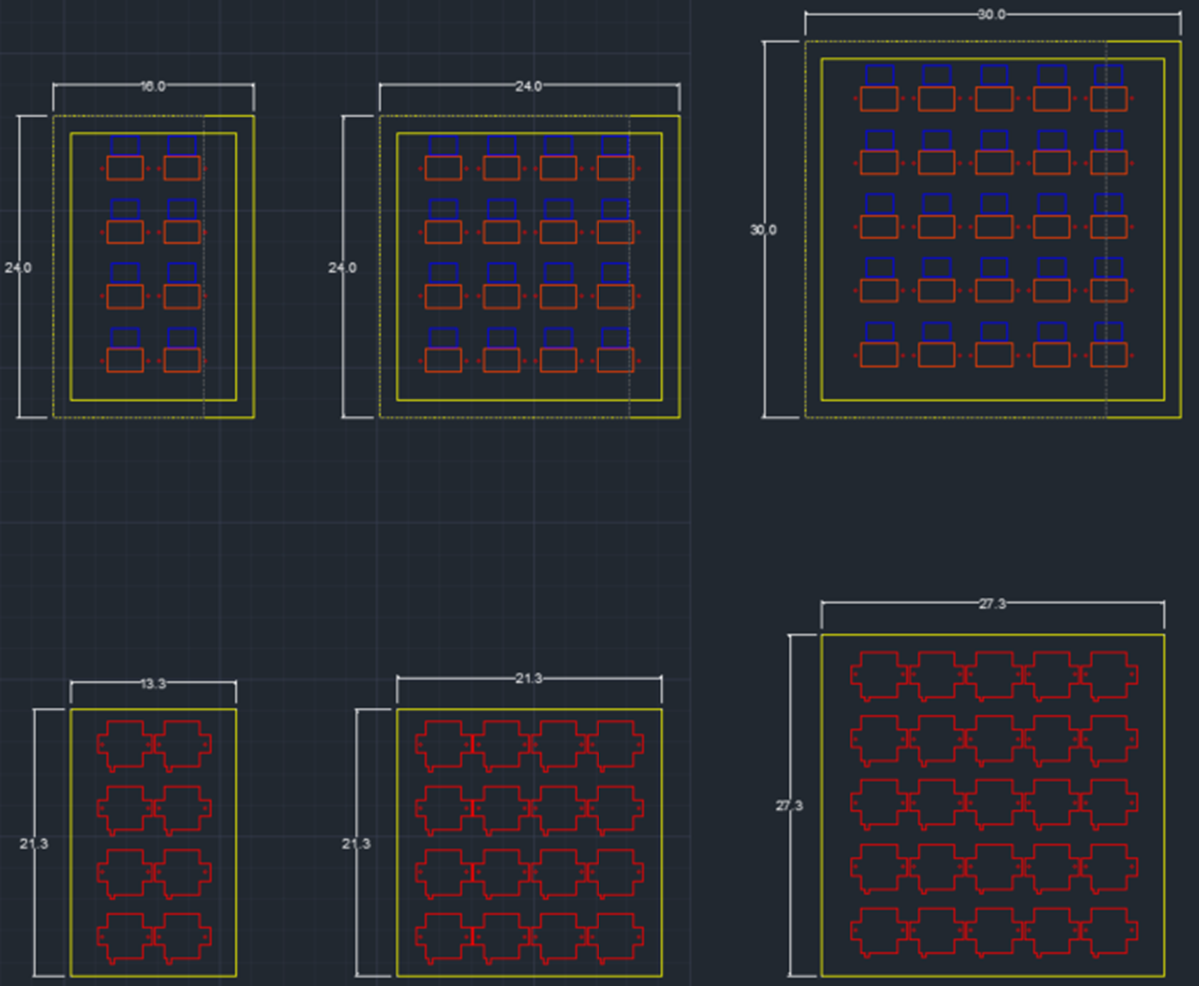
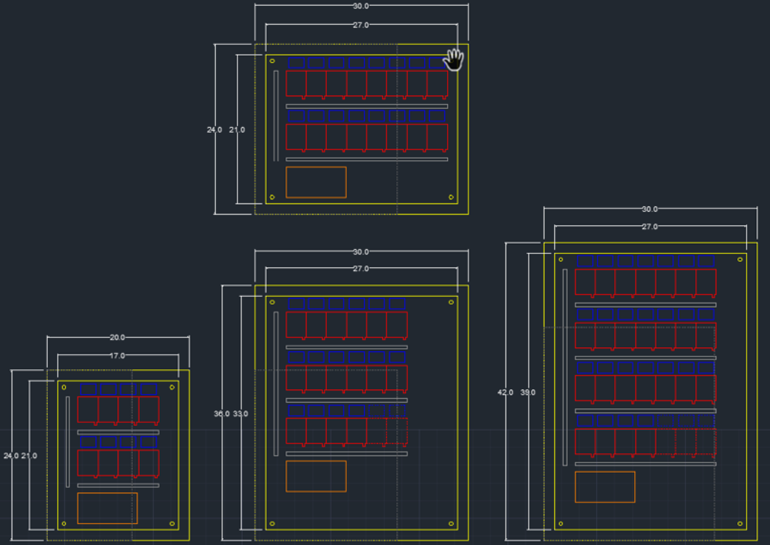
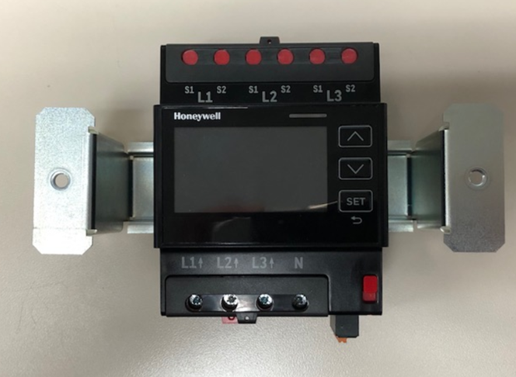
Enclosure options
R “Best NEMA 4X”
Ample room for installer
Keeps operator safe with dead front swing panel design
Optical transparent lid with window for display
Suitable for outdoor install
J “JIC STEEL type 1”
Heavy duty enclosure for indoor mounting
6” X 8” X 3”
6” X 8” X 3”
DRAK “DIN rail Adaptor kit”
Can be panel mounted in switch gear
Suitable for OEM applications
ER “Good NEMA 4X”
ER Economy Raintight
Lower cost to be competitive in market
Suitable for outdoor install
M “MMU”
Internal offer: 8, 16, 24 multi meter cabinets SKUs, or custom mounting.
Dead front panel adds safety vs legacy MMU
Line voltage factory pre-wiring reduces labor
6” X 8” X 3”
Notes:
Here is a look at the Class 6000 enclosures
The added room for installer to work inside the enclosure put smiles on the face of our beta installers
With the dead front swing panel design, it keeps the operator safe. The “DIN rail Adaptor kit” can be panel mounted in switch gear and is good for OEM applications.
I want to point out that the new MMU provides added safety benefits. The compactness of the new Class 6000 with the DIN adapter leaves more room to work on cabling, the “intermediate panel” protects access to wires, once closed it reduces the risk of electrical shock.

Slide 18
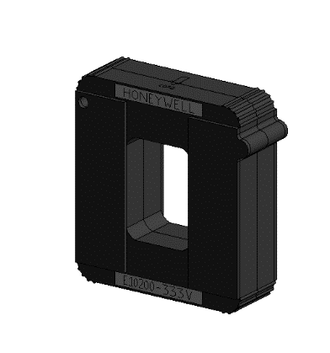
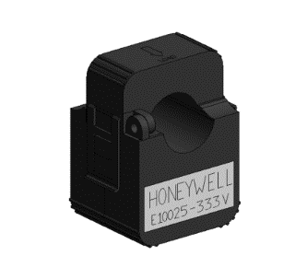
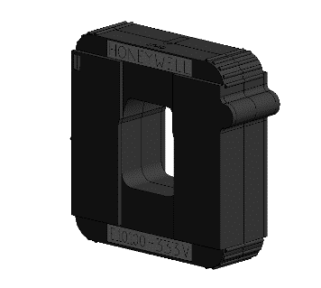
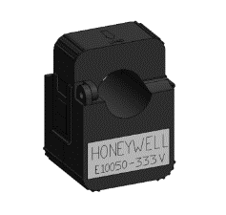
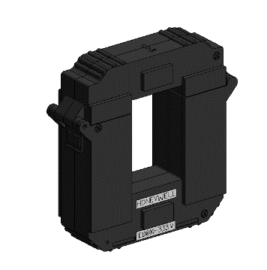
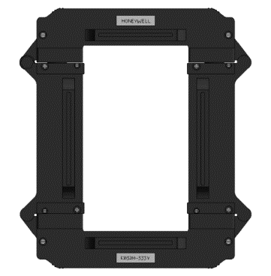
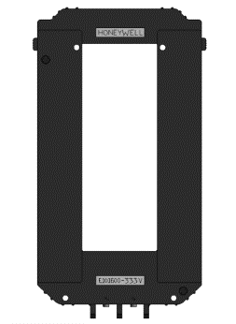
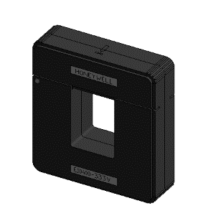
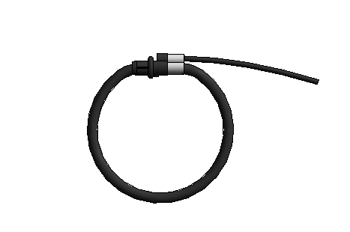
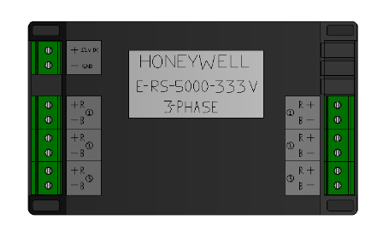

E-Mon™
Current sensors
New design 333 mV HACS
No more tie-wraps easy install
CS insulated for buss bar inst.
Legacy 2V CS compatible
Fit tight spaces compact
Intuitive arrow points to load
25 amp – 5,000 amp
Rogowski rope CS
UL Listed per 1951
Made in USA
25amp
50amp
100amp
200amp
400amp
800amp
1600amp
3200amp
5000amp Flex Coil
5000amp
Notes:
Here is a look at the available current sensors. Keep in mind that you will order current sensors at the same time you order your meter and enclosure. The E-Mon legacy 2V CS is compatible with the Class 6000. You can also use current sensors that may already be onsite. The Rogowski rope current sensor is new for Honeywell.

Slide 19
DESIGN
DESIGN
CYBERSECURITY
INSTALL
CYBERSECURITY
INSTALL
COMMISSION
COMMISSION
OPERATE
OPERATE
ANALYSE
ANALYSE

Slide 20

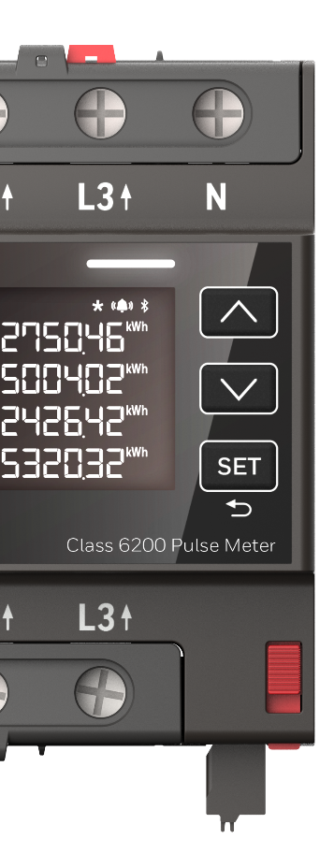
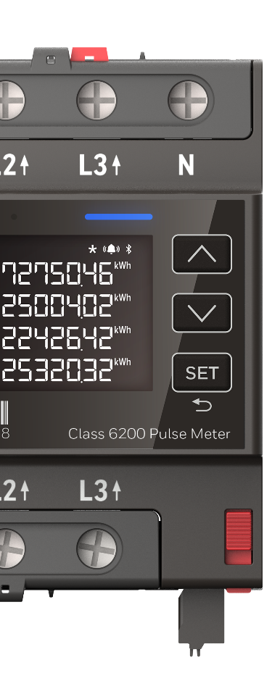
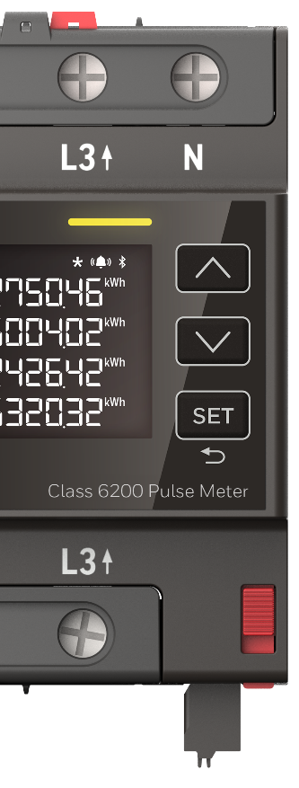
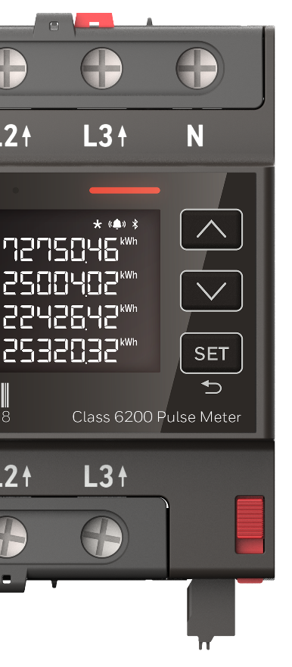

COMMISSION
FAST CONFIGURATION
ACCURATE STATUS DISPLAY
E-Mon App
  App-supported installation, commissioning and error rectification
  Includes basic parameter setup and templates for faster multi-meter setups
Automatic Wiring error
  Automatic error detection with easy-to-understand error messages
Notes:
Commissioning is one of the many highlights from both a feature and value proposition standpoint. The installer can commission directly from the display or from the Android app, which has a wizard that takes you through the set-up. This first release is only available on Android. The IOS app for Apple will follow. Also, you will find a wiring check function and it is worth noting that the meters are Field Configurable to Current Sensors.

Slide 21
DESIGN
DESIGN
CYBERSECURITY
INSTALL
CYBERSECURITY
INSTALL
COMMISSION
COMMISSION
OPERATE
OPERATE
ANALYSE
ANALYSE

Slide 22

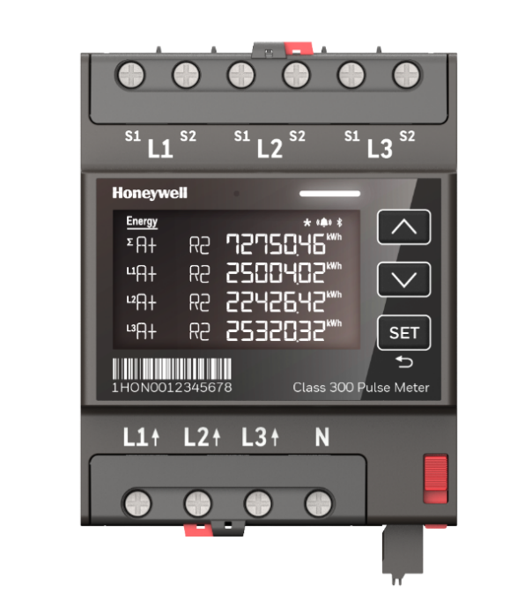
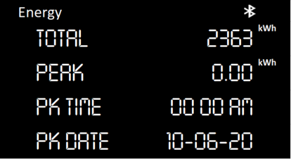
OPERATE
RELIABLE AND SECURE MEASUREMENT
  Energy active and reactive (QI-QIV)
    Total Energy (per Phase)
    Rated Energy
    Demand
    Maximum Demand
    Cumulative Maximum Demand
  Monitor (Instant)
    Voltage Phase-Neutral
    Voltage Phase-Phase
    Current
    Sum Active Power
    Active Power +
    Active Power –
    Reactive Power +
    Reactive Power –
    Apparent Power +
    Apparent Power –
    Etc.
  Profiles (via the app, coming soon)
    Billing Periods (configurable)
    Load Profile (15min)
    Load Profile (Day)
    Power Quality Profile
  200ms
  Power Quality (via the app, coming soon)
    Power Failures
    SAG
    SWELL
    CUT
    PF, THD, TDD (cf. Instant)
Notes:
The Class 6000 offers easy and reliable readouts with Bluetooth communication. On the left side of this display you see the energy measurements. The right-side displays variables you can instantly monitor. In the shaded area you see that the profiles and power quality features that are coming shortly after the Q4 launch

Slide 23
DESIGN
DESIGN
CYBERSECURITY
INSTALL
CYBERSECURITY
INSTALL
COMMISSION
COMMISSION
OPERATE
OPERATE
ANALYSE
ANALYSE

Slide 24
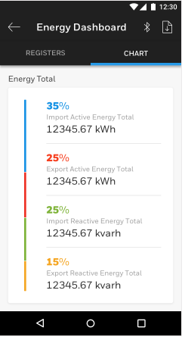
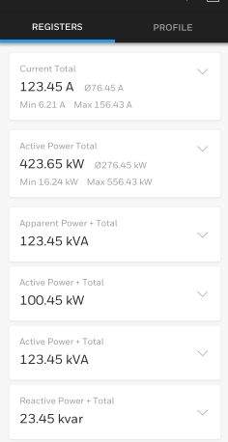
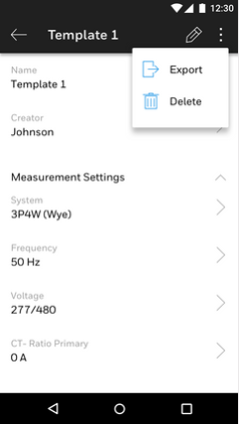
OPERATE & analysis
RELIABLE AND SECURE
OPERATION
Electronic readout
  Simple and secure readouts of meters via Bluetooth
  Intuitive app for commissioning, troubleshooting, readouts and monitoring of the meters
Notes:
The take-away in the analyze stage is that the Class 6000 provides reliable analysis of consumption data! And you can read that data right from the app!

Slide 25
DESIGN
DESIGN
CYBERSECURITY
INSTALL
CYBERSECURITY
INSTALL
COMMISSION
COMMISSION
OPERATE
OPERATE
ANALYSE
ANALYSE

Slide 26
CYBERSECURITY
HIGHEST LEVEL OF SECURITY THANKS TO CRYPTO CHIP
E-Mon Class 6000 meters are the among the only submeters that offer overarching cybersecurity. The encrypted communication serves as a basis for a secure communication.
Crypto chip
  Separate crypto processor
  reliably protects sensitive data
COMPREHENSIVE
CYBERSECURITY
Notes:
Thanks to the Crypto Chip, the encrypted communication serves as a basis for a secure communication. The E-Mon Class 6000 meters, indeed, are the only meters that offer this level of cybersecurity.

Slide 27

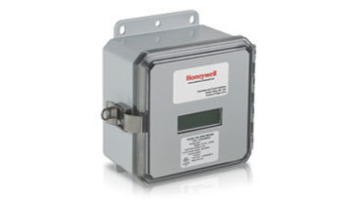
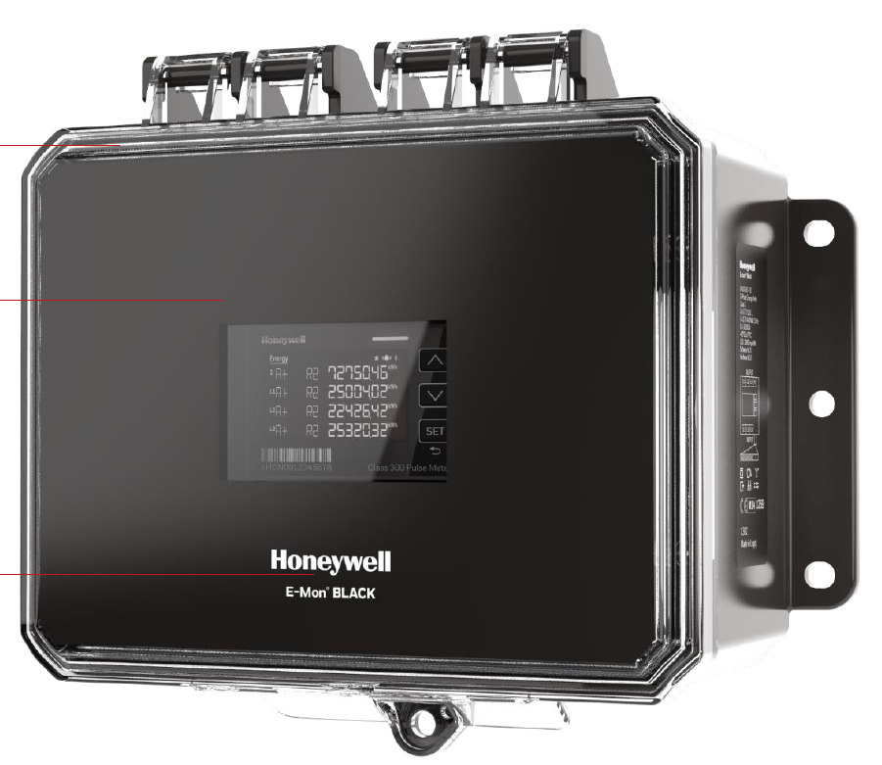
E-Mon Class 6000 vs legacy
Features | E-MON Class 2000 | E-MON Class 6200 Pulse | E-MON Class 3200 | E-MON Class 6310 RS-485
Simple SKUs (Stock-able) 1ph/3ph Capable | No | Yes | No | Yes
Communication Options | Pulse | Pulse, BLE | Pulse, Modbus, BACnet, EZ7 | Pulse, BLE (Modbus and BACnet soon)
Easy Fail-Safe Wiring and Commissioning | No | Yes (more room to wire with swing panel | No | Yes (more room to wire with swing panel)
Advanced Cybersecurity | No | Yes | No | Yes
Measurement | CS not Field Configurable | Direct, CS, including Rogowsky, field configurable | CS not Field Configurable | CS, Field Configurable
Notes:
This graph does a good job of sharing with you the features of our legacy products, the Class 2000 & Class 3200, as compared to the new Class 6000.
The first thing I will point out is with the launch of the Class 6200, this product will replace the Class 2000 over time.
The Class 6000 is a stockable product. E-Mon went from hundreds of SKUs to 1 meter for all applications – easy to stock and order. Plus it is field configurable. This allows for the distributor to keep what you need in inventory, as well as for the contractor to keep the “right” meter on hand in his truck at all times!
I mentioned this earlier in my presentation, however it’s worth noting again for any BMS integrators in the audience that the Class 6310 will launch early in 2021, this release will include serial communication RS485.
We talked about the easy fail-safe wiring and commissioning and the value of the cyber security the Class 6000 provides. Most importantly the Class 6000 is field configurable.

Slide 28
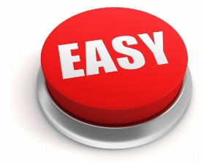
Support and more information
PRODUCT INFORMATION
Building Controls
buildingcontrols.honeywell.com
CONFIGURE + QUOTE
CPQ Select
cpq.honeywell.com
LEARNING HUB + WEBINARS
Go.bluevolt.com/Honeywell
SUPPORT
Tech Support
emon-techsupport@Honeywell.com
1-800-334-3666, option 3
Patty Hall
Patty.a.hall@Honeywell.com
540-597-8362
Notes:
I hope you are as excited as I am about this new product! We are getting ready to wrap up and move into the Q & A, however before doing so I want to share with you where you can get more information on Honeywell E-Mon’s legacy and new Class 6000 products. You can go to the BuildingControls website where you will find sales and data sheets, technical literature, white papers, engineering spec and much more.
Honeywell’s online CPQ site is available to you. It is an online configurator that allows for simplified and faster product selection.
On the right side of the screen you will find Honeywell’s online learning hub, available to you. And lastly, the E-Mon tech support line, as well as my contact information.

Slide 29
THANK YOU
Notes:
That concludes this sessions Q&A, before we finish, I would just like to encourage you to visit the BuildingControls.Honeywell.com website for more information.
Thank you and have a great day! (SMILE!)

Slide 30
Q&A
Do I need to configure my Class 6200 after installation?
    Yes, it is required to follow one of this option for configuration, or the meter will not work properly:
      Meter Display : Setup > Parameters, then go through all settings and select accordingly (system wiring, voltage, CS ratio, etc.)
      App wizard: Just launch your E-Mon Android app and select: “Quickly commission a meter” or use directly the Parameters or Template menu
  Is it available with communication?
    Our next release in 2021 will include serial communication RS485
    Currently the 6 pin port only includes 2 separate configurable Pulse outputs (cf. installation instructions)

Slide 31
Q&A
  Do I need an Android phone/tablet to be able to use my Class 6200 meter?
    No, all key functions of the meters are available via the menu on the display, such as the Parameter selection, Wiring check, Monitoring values, etc.
    The current app is only available on Android and brings additional help during commissioning (and readouts), but we plan to release an iOS version soon
    Also, for advanced functions and readouts, navigation on smartphone/tablets is faster than on meter display
  How should I wire the ground on the different enclosures?
    Only the J-steel enclosure must be grounded, as specified on related document: installation instructions for standalone enclosures (p.4)
    NB: All enclosures are UL61010 listed

Slide 32
Q&A
  What is the function of the red button on lower right side of the meter front panel
    This is the sealing button which allows to lock all parameters related to sub-billing after commissioning
  Can I mix legacy E-Mon meters and Class 6200 meters in the same MMU cabinets.
    No, new and improved MMU cabinets have been designed for Class 6200
    Please note that DIN kit accessories are available for mounting Class6200 in third party cabinets (SKU: EM3S-P-V-M, including the DIN meter and the mounting kit)

Slide 33
Q&A
How is the accuracy certified on Class6200?
    E-Mon Class 6200 is a revenue grade meter with a ANSI C12.20 certificate (Class 0.5), like our legacy E-Mon bestsellers
  Do I need to set the Pulse parameters during commissioning
    Default values : 30ms duration and 1kWh Pulse ratio should match typical applications
    Be careful: these default values are DIFFERENT from legacy Class 2000
    For higher CS ratio settings, we provide a table to explain how Pulse parameters should be changed in the Setup – Parameters menu on the display or via the app

Slide 34
E-MON® HIGHLIGHTS
THROUGHOUT THE ENTIRE PROCESS,
THOUGHT OUT DOWN TO THE VERY LAST DETAIL
    Safer to install with improved enclosures, cabinets and current sensors
    1 meter for all applications = easy to stock and order
    Fast and Failsafe commissioning, especially for several meters

Slide 35
Certification and approvals
EU
    MID Certification
      EN 50470 Class C Device
      (IEC 62053-21 Class 0.5)
USA
    UL Approval
    ANSI 12.20 Class .5
    Coming Soon
      NYCRR-16 Part 96 Approval
      California Title 24
      Mexico
Canada
    Measurement
    Canada LMB-EG-07 (Coming Soon)
Middle East
    Coming Later

